Slide 1

Arooj Fatima
Data Analyst Portfolio

Slide 2

About Me
My name is Arooj Fatima. I did Bachelors in English Linguistics & Literature. With my experience as a teacher, I bring excellent communication, critical thinking, and mentoring skills to every role. Known for my adaptability and commitment to continuous learning, I am now combining my analytical mindset with technical expertise to uncover insights and drive-data informed decisions. Eager to contribute a unique blend of creativity, precision, and problem-solving to dynamic teams.

Slide 3





Projects
Gun Violence
Gun violence incidents analysis in the US to identify patterns
Skills:
Game Co
Global video game sales analysis
Influenza
Allocation of medical staff to prepare for the influenza season
Rockbuster
Analysis of customer rental behaviors to support an online streaming service
Instacart
Analysis of customer demographics and purchasing patterns
Pig E. Bank
Customer retention analysis for a global bank
Skills:
Skills:
Skills:
Skills:
Skills:

Slide 4

Game Co
Game Co, a newly established video game company, aims to leverage data analysis to comprehend market trends, formulate strategic plans, and drive growth in the most viable markets."
Objectives
Methods
Analyse global sales trends over the past years
Identify top-performing platforms and publishers to understand market competition
Grouping, Sorting and filtering data in Excel
Data cleaning
Descriptive analysis
Data visualization

Slide 5




Game Co / Analysis
Percentage of Regional sales by year
The graph shows North America as the leading market across most genres, with Japan surpassing North American sales only in the Role-Playing genre by a noticeable margin.
60.00%
50.00%
Regional Sales Propotion by Genre
100%
90%
7% 8% _{9%} 6%
5%
6%
8%
6%
40.00%
11%
11% 10%
10%
9%
13%
16%
8%
4%
16%
10%
80%
70%
60%
50%
22% 19%
23%
28%
30.00%
38%
30%
30%
27%
24%
33%
28%
20.00%
27%
23%
21%
29%
26%
10.00%
20%
40%
30%
20%
10%
0.00%
50%
50%
51%
54%
51%
49%
56%
51%
44%
47%
39%
35%
Sum of Proportion_NA sales Sum of Proportion_JP sales
Sum of Proportion_EU sales Sum of Proportion_Other sales
0%
The data shows a significant shift in regional game sales: North America’s share is declining, while Europe’s is steadily increasing, and Japan’s is seeing a notable rise.
Sum of Other Proportion Sum of EU Proportion
Sum of JP Proportion Sum of NA Proportion

Slide 6
Game Co / Recommendations
Reallocate Marketing Budget: Increase the marketing budget for Europe and other emerging regions to support their growth. Reduce the budget for Japan to reflect its declining market importance.
Targeted Marketing Campaigns: Develop targeted marketing campaigns that connect with local audiences, regional culture and consumer preference. Use digital marketing tools such as social media, influencer partnerships to engage with customers effectively.
Market Monitoring: Regularly monitor sales data, market trends, and consumer behavior.
Performance Feedback : Collect feedback from regional teams and consumers to continuously improve marketing efforts and address any issues. To measure the effectiveness of marketing strategies and campaigns.
Invest in Market Research: Conduct in-depth marketing research in Europe and other emerging regions to understand the behavior of consumers. Use these insights to refine marketing strategies.
Final Project Presentation

Slide 7

Influenza Season
During the U.S. flu season, cases rise among vulnerable populations, prompting hospitals to depend on staffing agencies for temporary healthcare workers.
Objectives
Methods
Grouping, integration, profiling and hypothesis test
Forecasting
Data visualization and
storytelling
Provide a plan for influenza season
forecasting additional staff demand.
Examine trends in influenza and use it to plan staffing needs across the country.

Slide 8
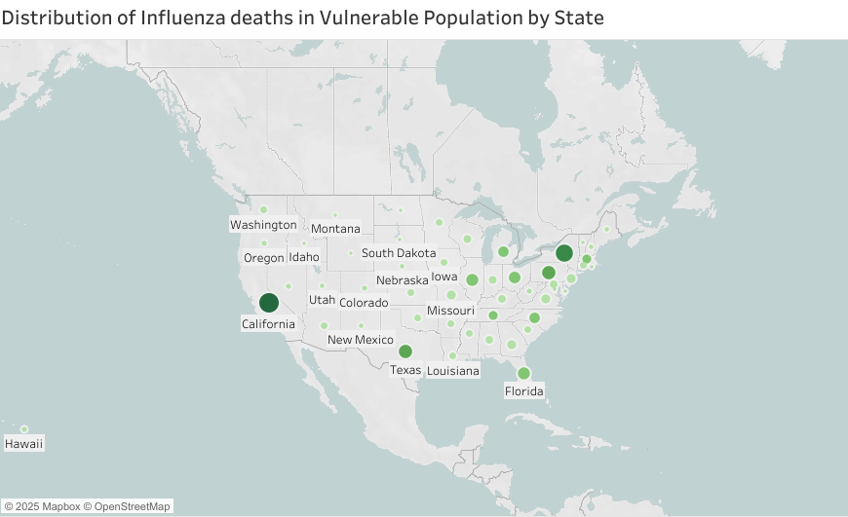
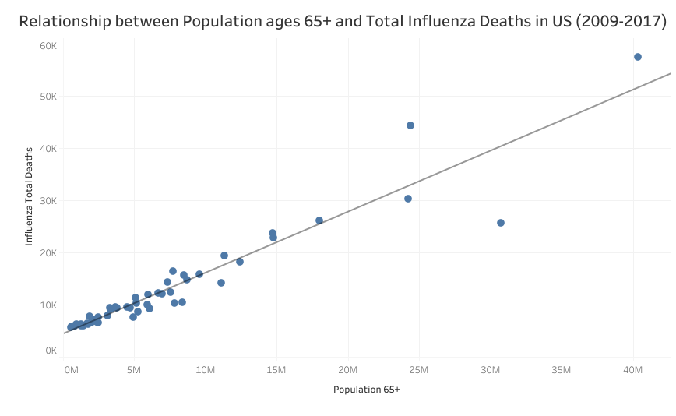
Influenza / Analysis
California is the U.S state with the most deaths by Influenza, while Alaska is the state with the least deaths.
There is a positive correlation between the number of senior population and influenza deaths, which means that in states with a higher population of 65+ years olds, there will be more deaths by influenza.

Slide 9

Influenza / Recommendations
01 Prioritized Vaccination for Vulnerable Populations
Focus vaccination efforts on populations at the highest risk of influenza complications, particularly individuals over the age of 65 and children under the age of 5.
02
Enhanced Resource Allocation in
High-Risk Regions
03 Real-Time Monitoring and Regional Support
West and Northeast states show higher deaths counts.
Efficiently distribute healthcare resources to regions with
historically higher influenza-related fatalities, particularly in
states with older populations and healthcare shortages.
Monitor key healthcare resources during the peak months (December to March), ensuring healthcare facilities are prepared to handle increased patient loads.
Strengthen surveillance systems for timely data collection and share insights with healthcare facilities for quick responses.
Allocate additional support to regions that experience unexpected surges.
Tableau Visualizations Interim Report

Slide 10

Rockbuster Stealth
Rockbuster Stealth LLC, once a global leader in movie rentals, intends to introduce an online video rental platform to compete with streaming industry giants such as Netflix and Amazon Prime.
Objectives
Methods
PostgreSQL
Data Cleaning & Filtering
Joining Tables
Subqueries & CTEs
Data Visualization
Deliver data-driven insights to help the Rockbuster Stealth LLC management team strategically launch their new online video rental service.

Slide 11
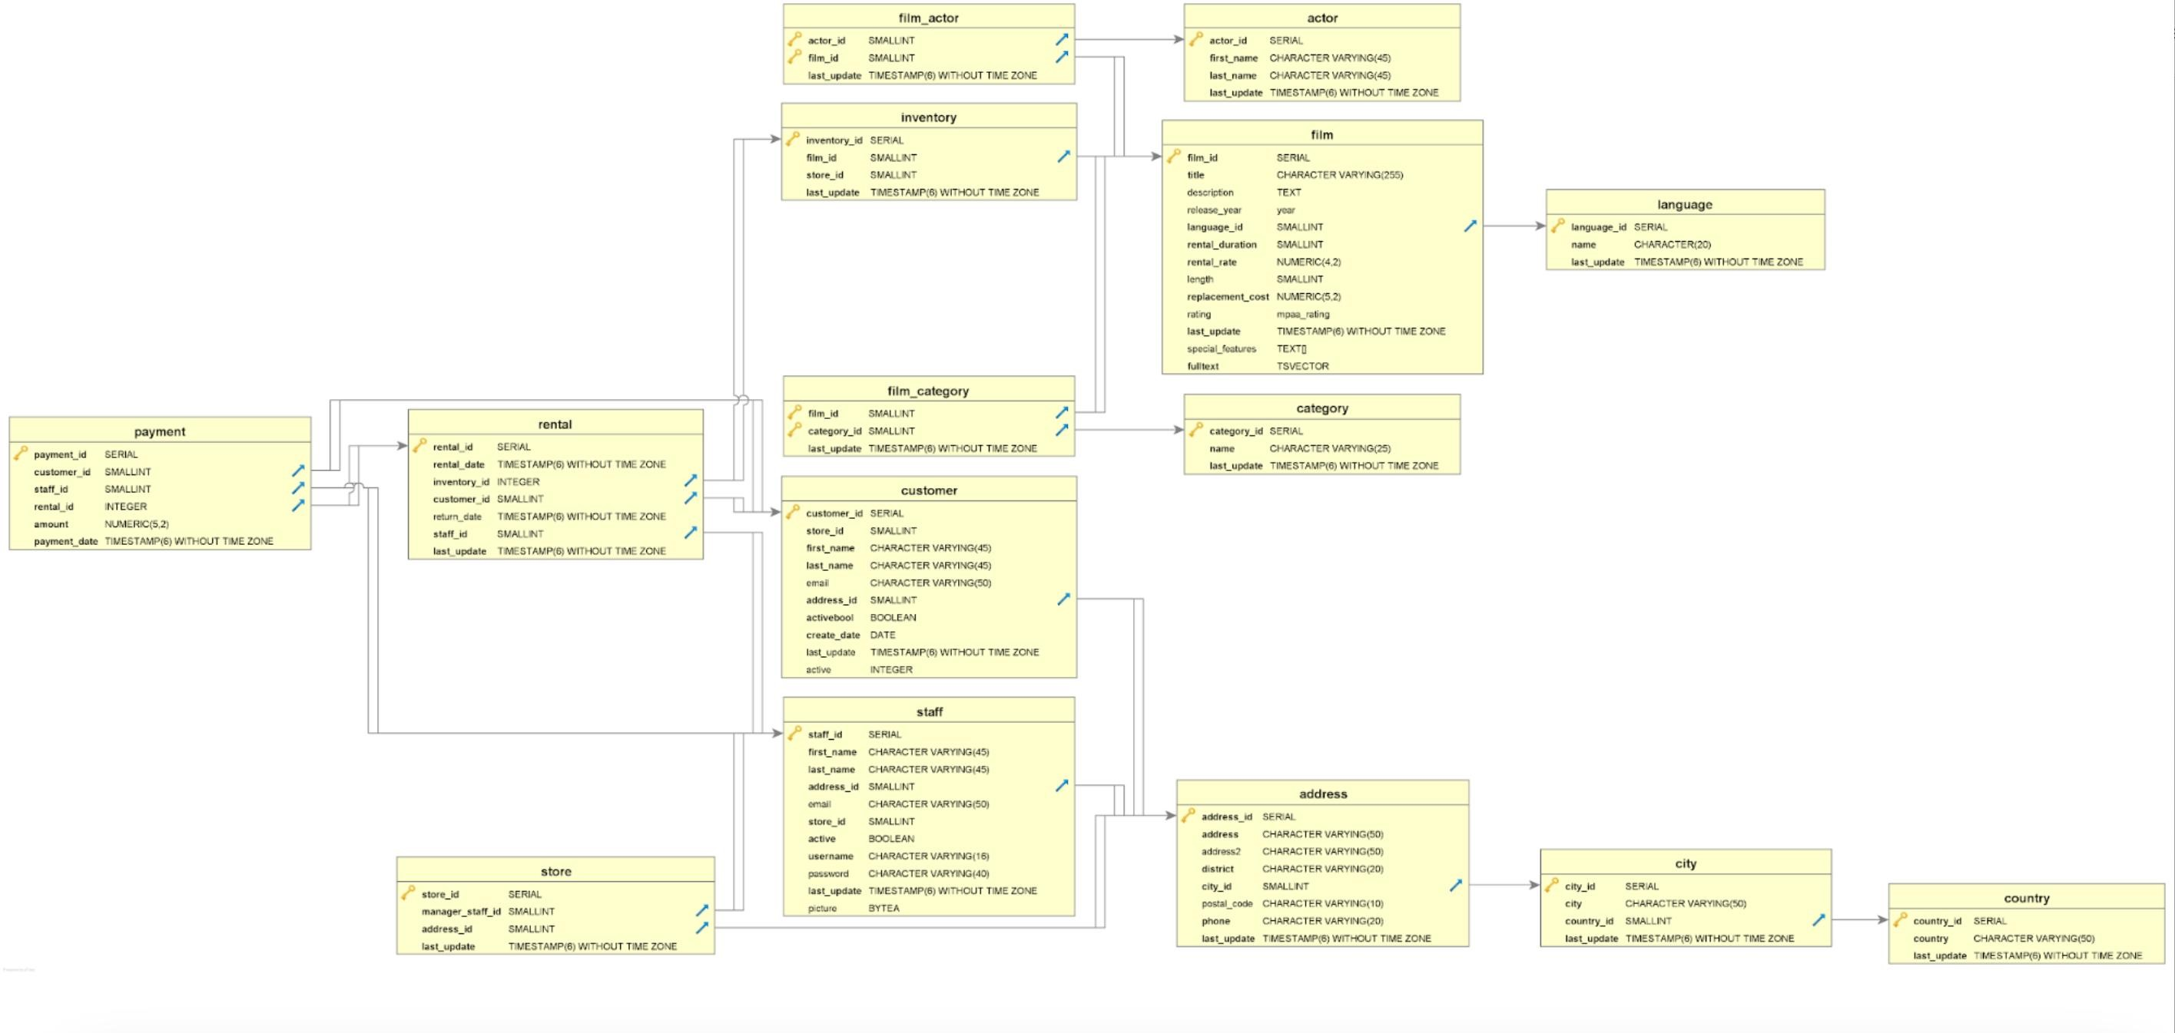
Rockbuster / Analysis
Entity Relationship Diagram ( ERD):

Slide 12
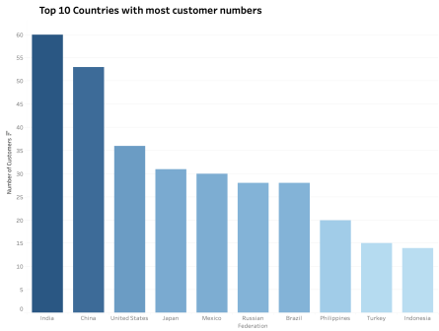
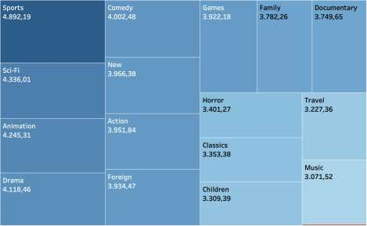
Rockbuster / Analysis
Revenue by movie genre
The most important category for Rockbuster's business is Sports, followed by Sci-Fi, Animation, and Drama.
Generally, the revenue across each genre is fairly homogeneous, except for the Thriller genre, which has only 47,89 revenue.
The current rental service has the highest number of customers in India and China.
The rankings of customer numbers are largely consistent with the revenue rankings.

Slide 13
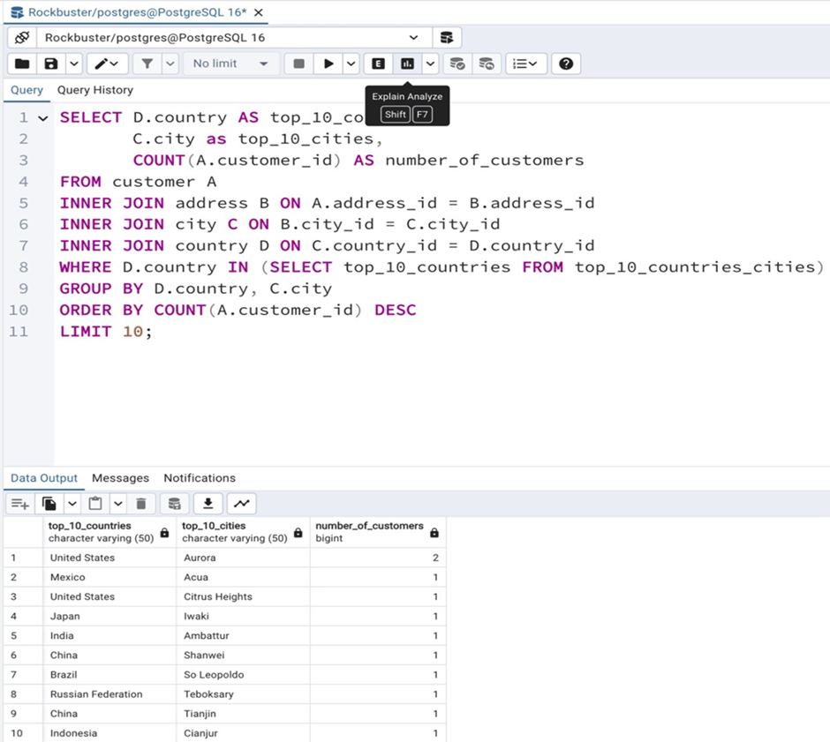
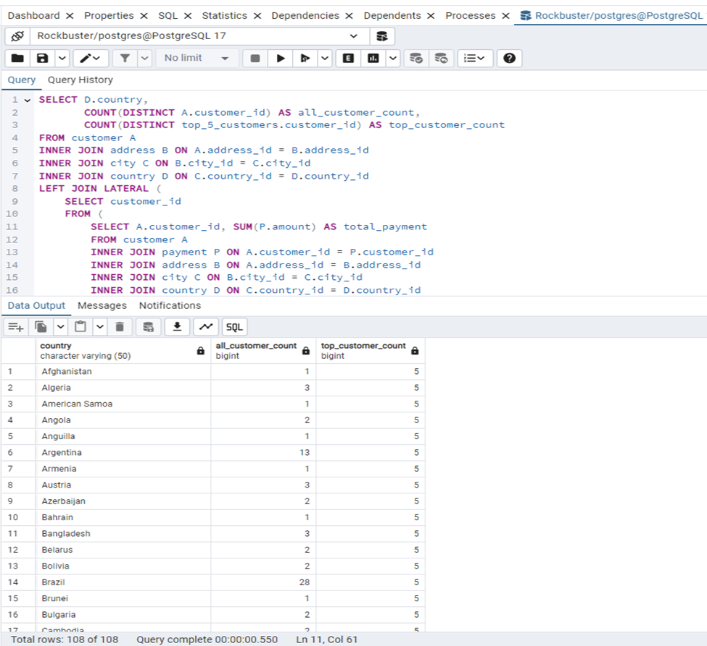
Rockbuster / Analysis
Join SQL Query Subquery

Slide 14
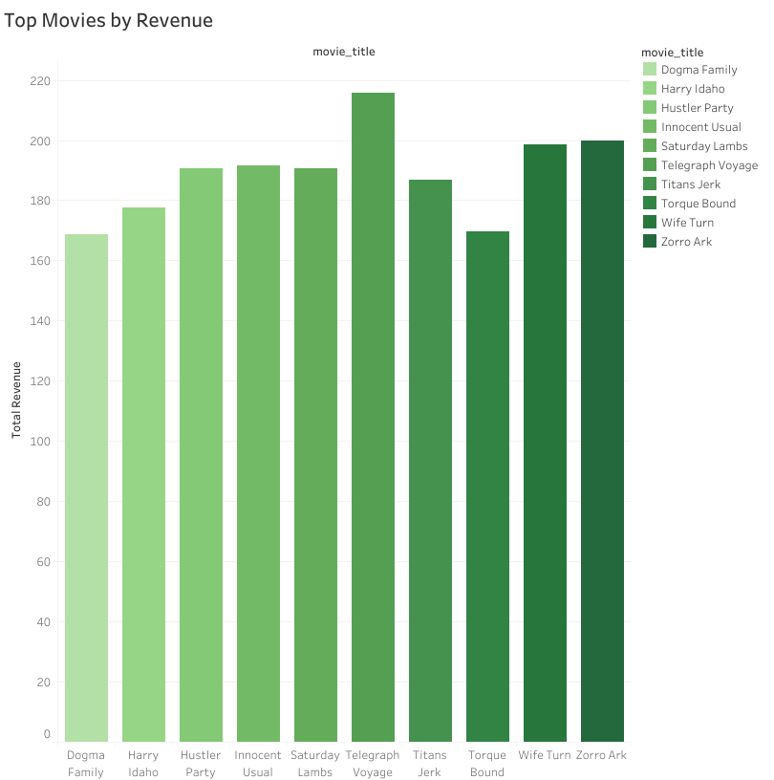
Rockbuster / Analysis
 | Rental Duration | Rental Rate | Film Length
Average | 5 | 2,98 | 115
Minimum | 3 | 0,99 | 46
Maximum | 7 | 4,99 | 185
Rental data indicates an average duration of 5 days, with prices ranging from $0.99 to $4.99.

Slide 15

Rockbuster / Recommendations
01 Primary Market:
India, China and the United States have the largest customer bases and generate the highest revenue, making them key markets for Rockbuster Stealth to prioritize in future growth strategies.
02 Invest in Top Genres:
03 High-Value Customer Programs:
Increase focus on Sports, Sci-Fi, Animation and Drama movies, which demonstrate strong performance in generating revenue. Regularly update the library with popular titles in these categories to attract and retain customers.
Develop loyalty programs and exclusive promotions for high-value customers to encourage sustained engagement.
Project
Presentation
Tableau

Slide 16

Instacart
This project uses Python to analyze Instacart's grocery data, uncovering key sales trends and customer behaviors. The insights assist in optimizing marketing strategies, identifying peak sales periods, and understanding product popularity for better customer segmentation.
Objectives
Perform an exploratory analysis of the customer purchase history data to uncover patterns that will benefit the marketing and sales departments in marketing campaigns and promotional efforts.
Methods
Data wrangling & Data subsetting
Consistency checks
Merging data frames & deriving
variables
Grouping & aggregating data
Data visualization with python.

Slide 17
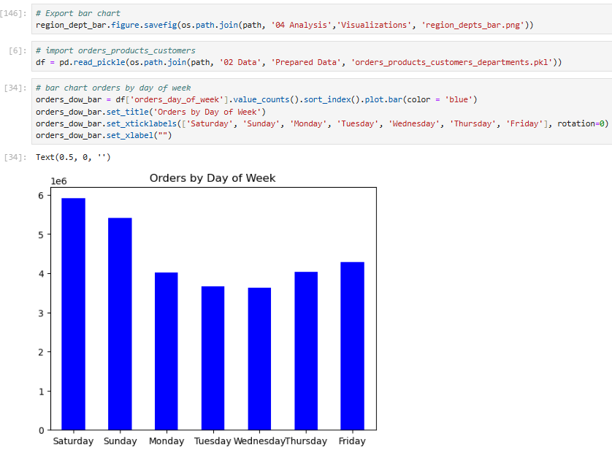
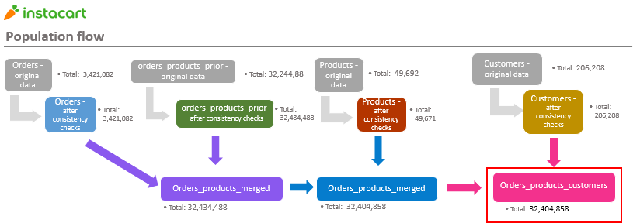
Instacart / Analysis
Saturday and Sunday are the busiest day of the week. Tuesday and Wednesday are the least busy days of the week.
.

Slide 18
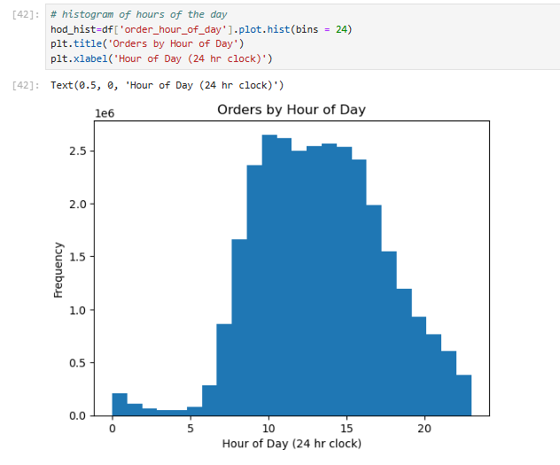
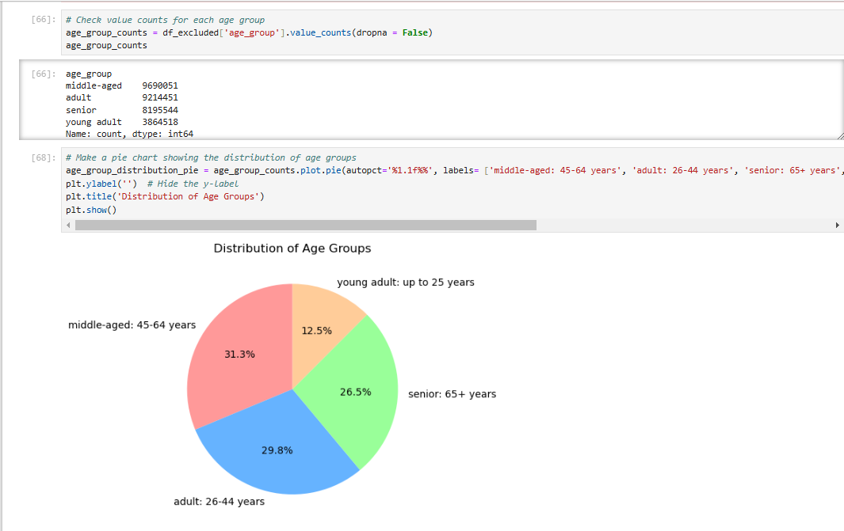
Instacart / Analysis
Sales are higher in the early morning, but there is a dip between 9:00 and 10:00.

Slide 19
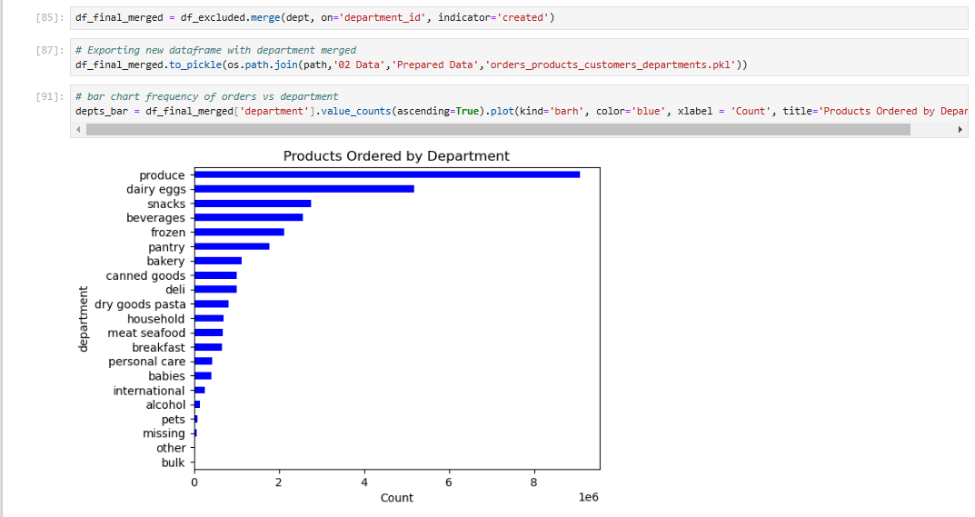
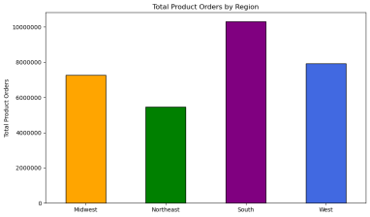
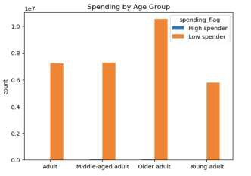
Total Product Orders are more in south and west regions, may be due to high population.
Most customers are considered to be low spenders.
The bar chart shows the best seller products come from produce.
The next most ordered from departments are
dairy/eggs, snacks, beverages, and frozen.

Slide 20

Instacart / Recommendations
01 Busiest time:
Implement sales and promotions specifically in the middle of week to boost sales activity.
Schedule ads during the times 6 am to 8 am and 5pm to 10 pm.
02
Products:
Promotions and discounts on popular categories like Produce and Dairy could encourage customers to place orders more frequently.
Similarly, targeted deals on less popular categories such as International, Alcohol, and Bulk items may help stimulate interest and increase sales in those departments.
03 Customers:
04
Regions:
Instacart should focus on converting new customers into regular or loyal customers with welcome promotions and incentivize regular customers with discounts to boost loyalty.
Prioritize advertising in the South while also targeting growth opportunities in the West and Midwest.
Excel Report

Slide 21

Pig E. Bank
Pig E. Bank is a global financial institution with a dedicated anti-money laundering compliance department.
Objectives
Methods
Determine the primary risk factors contributing to client loss and represent them using a decision tree model
Provide recommendations to
increase customer retention
Exploratory data analysis
Data mining techniques
Data cleaning
Consistency checks
Data modelling
Linear regression

Slide 22
Pig E. Bank / Analysis
Comparison by Number of Products
NO. of Products | Clients Remained | Clients Exited
1 | 46,82% | 69,61%
2 | 52,54% | 15,69%
3 | 0,64% | 13,73%
4 | 0,00% | 0,98%
Comparison by Activity
Count of Active Member | Clients Remained | Clients Exited
0 | 43,77% | 70,10%
1 | 56,23% | 29,90%
Comparison by Age
Count of Age | Clients Remained | Clients Exited
18-29 | 17,56% | 4,90%
30-39 | 50,38% | 24,51%
40-49 | 22,52% | 41,67%
50-59 | 5,60% | 18,63%
60-69 | 2,54% | 10,29%
70-82 | 1,40% | 0,00%
Comparison by Gender
Count of Gender | Clients Remained | Clients Exited
Female | 43,44% | 59,31%
Male | 56,56% | 40,69%
After analyzing the bank customers’ data, I noticed that most of the clients who left the bank were aged between 36 and 64 years old, were not active users and only had one product.

Slide 23
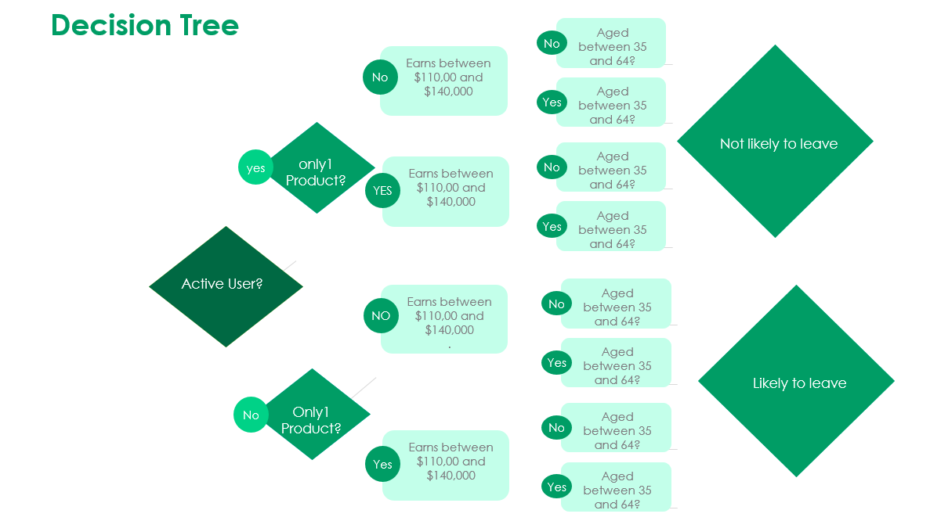
Pig E. Bank / Analysis
Age>40
Likely to leave
Only 1 product
Age<40
Not active
Age>40
Customer Exit Bank
More products
Age<40
Age>40
Only 1 product
Age<40
Active
Likely to stay
Age>40
More products
Age<40

Slide 24
Pig E. Bank/ Recommendations
01 Customer Retention:
Focus on building a base of active customers who use multiple products by promoting engagement and account activity.
02
Customer Insights:
Conduct surveys to understand why some customers are inactive and identify changes or new products that could increase their engagement.
04
Customer Engagement:
03 Product Promotion：
Increase engagement with older, high- balance clients through personalized strategies and support German clients with tailored loyalty programs.
Cross-sell additional products to low- product clients and align offerings with customer interests.
Excel Report

Slide 25

Gun Violence
Gun violence is a major public safety concern in the United States, impacting thousands of lives each year. This project analyzes gun-related incidents across different states and cities, identifying trends, patterns, and risk factors.
Objectives
Methods
Identify high-risk states and cities with the most gun violence incidents.
Analyze seasonal trends and time-based patterns in gun-related incidents.
Examine the correlation between the number of firearms involved and fatalities.
Use clustering techniques to categorize incidents based on severity.
Provide actionable recommendations for policymakers and law enforcement.
Exploratory Data Analysis (EDA)
Data Cleaning & Processing
Regression Analysis
K-Means Clustering Time-Series Analysis
Data Visualization in Tableau

Slide 26
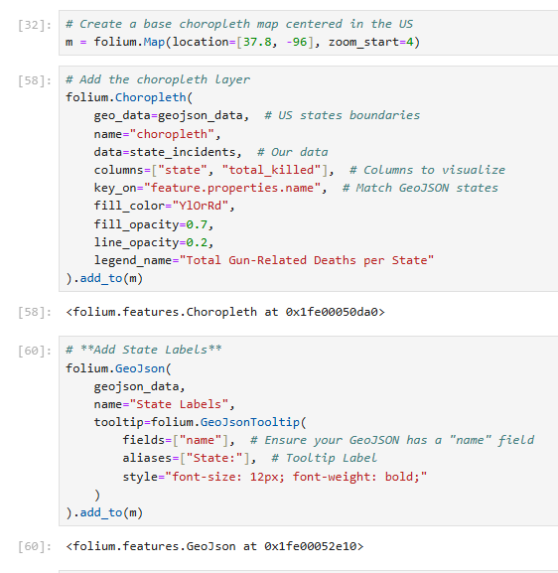
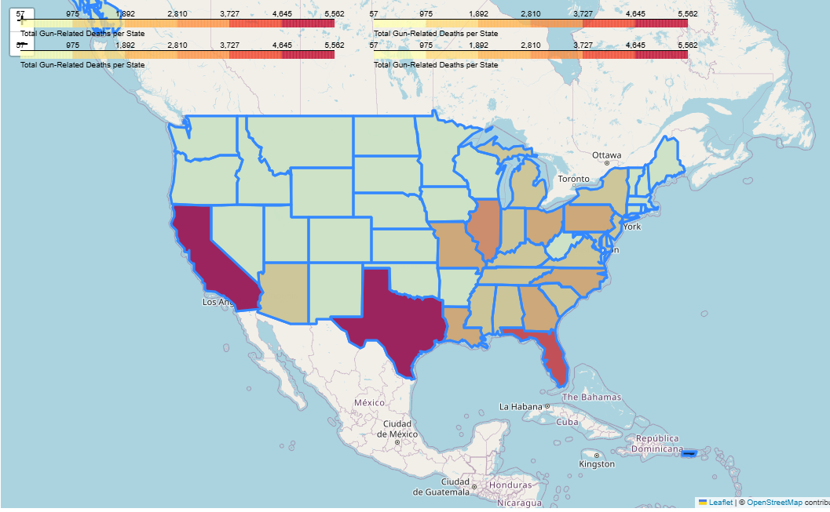
Gun Violence/ Analysis
The choropleth map provides a clear visualization of gun-related deaths across U.S. states. The darker regions indicate states with higher fatality rates, highlighting states such as California, Texas, and Florida, where gun-related deaths are significantly higher. This could be due to factors such as population density, state gun laws, or socio-economic conditions.

Slide 27
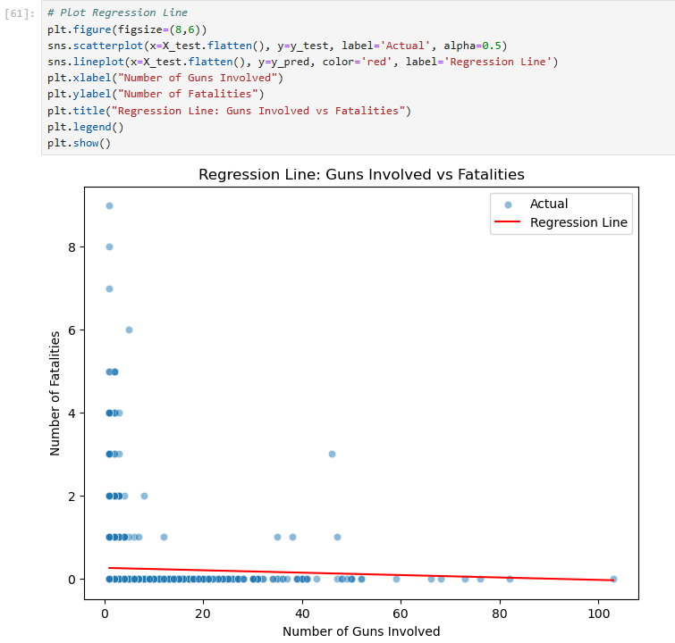
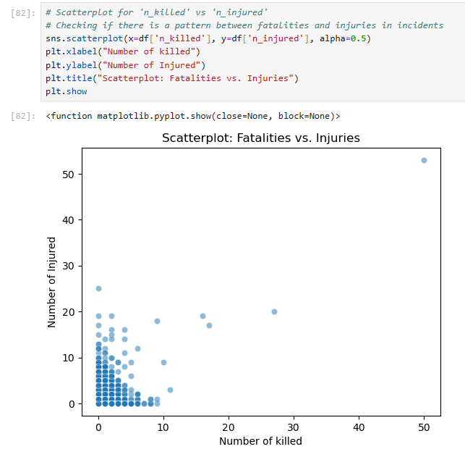
Gun Violence/ Analysis
Positive Correlation:
The plot suggests a positive correlation between the number of fatalities and injuries in gun violence incidents.
Incidents with a higher number of fatalities also tend to have more injuries, though there is some variation.
Density at Lower Values:
Most data points are clustered near the lower left, indicating that most incidents involve a small number of fatalities and injuries.
A large number of cases have zero or very few fatalities, with only injuries reported.
Outliers with High Fatalities:
A few data points show extremely high fatalities (20–50 deaths), indicating mass shooting events.
These high-impact incidents are relatively rare but significantly more severe.
The regression line fits the data relatively well, showing a clear positive trend between the number of guns involved and fatalities. However, there is still some spread in the data points, indicating variability that is not fully captured by a simple linear model.

Slide 28
Gun Violence/ Recommendations
01 Public Improvements:
✔ Strengthen gun control regulations in high-risk states based on data insights.
✔ Implement background checks and stricter firearm access laws.
02
Law Enforcement Strategies:
Deploy additional law enforcement resources in high-incident areas.
Enhance community policing and rapid response systems for high-severity incidents.
03 Public Awareness:
04
Data-Driven Decision Making:
Launch awareness campaigns focusing on high-risk timeframes (weekends, summer).
Educate communities about conflict resolution and responsible gun ownership.
Utilize predictive analytics to identify future gun violence hotspots.
Integrate socioeconomic and mental health data for deeper insights into incident causes.

Slide 29



My Contact:

